Slide 1
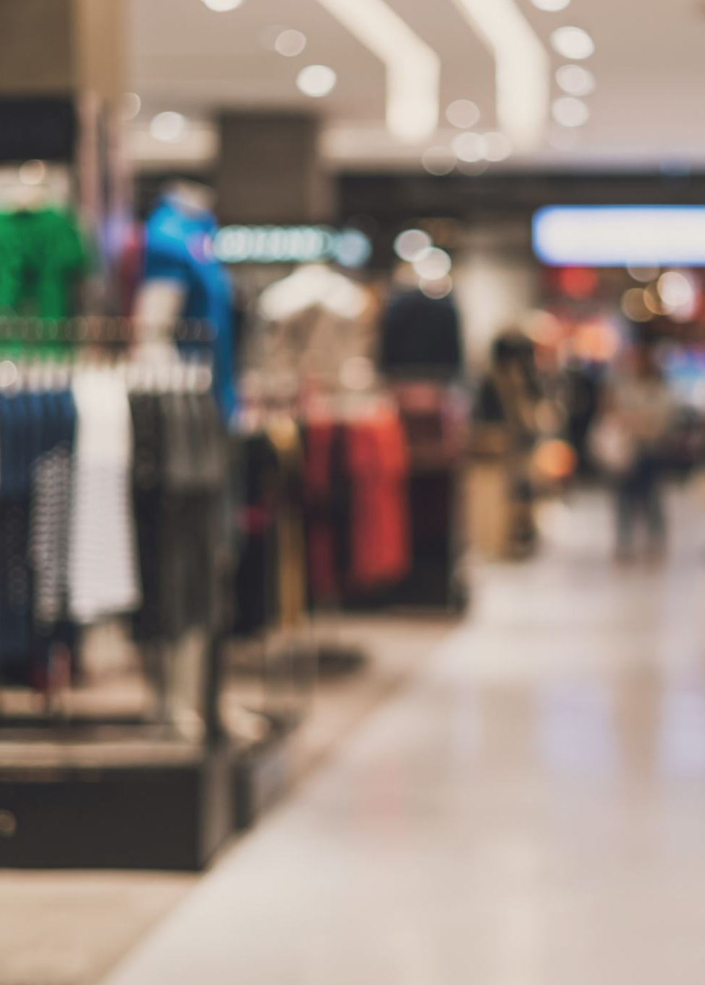
CUSTOMER SHOPPING BEHAVIOUR ANALYSIS USING POWER BI
Analytical Tool: Microsoft Power BI
NEHA M

Slide 2
INTRODUCTION
Customer shopping behaviour generate large amounts of data related to products, customers, purchases, payments, and deliveries.
This project uses Microsoft Power BI to analyze transaction data and identify meaningful business patterns.
It evaluates product categories, brand performance, and purchasing quantities to understand product performance.
Customer purchasing behaviour is analyzed using subscription status, purchasing frequency, and customer demographics.
Payment methods, delivery performance, product returns, and customer review ratings are examined to identify operational patterns.
The interactive dashboard transforms raw data into visual insights that support data-driven decision-making and improved Customer behavioral performance.

Slide 3
BUSINESS QUESTIONS
Which product categories generate the highest purchase amounts?
Which brands contribute the most to the total purchase amount?
Which products have the highest purchase quantities?
How does purchase amount vary across promotional occasions?
Which product sizes and colours have the highest purchasing quantities?
How do purchasing patterns vary across customer demographics?
What is the distribution of subscribed and non-subscribed customers?
Which payment methods are most commonly used by customers?
How does average delivery time compare between Express and Standard delivery?
How many transactions involve returned products, and how do customer review ratings vary?

Slide 4
DATA OVERVIEW
SOURCE
KEY FIELD
ANALYTICAL OUTPUTS
Customer ID
Age and Gender
Product Category
Brand and Item Purchased
Purchase Amount and Quantity
Season / Promotional Occasion
Payment Method
Subscription Status
Delivery Speed and Delivery Time
Review Rating
Return Information
Product & Brand Performance Analysis
Product Purchase Details
Festive Sales & Category Analysis
Customer Purchase Behaviour Analysis
Delivery & Payment Analysis
Dataset : Customer Shopping Behaviour Dataset
Analytical Tool: Microsoft Power BI
Data Preparation: Power Query
Analysis and Visualization: DAX and Power BI

Slide 5
CHANGELOG - DATA CLEANING & TRANSFORMATION
SL. NO. | CHANGE MADE | PURPOSE
1 | Duplicate Check | Checked for duplicate records; no duplicates were found.
2 | Missing Value Check | Checked for null and blank values ,none were found.
3 | Category Consistency Check | Verified product categories for consistent formatting; no changes were required.
4 | DAX Measure Creation | Created measures to calculate KPIs and analyze customer shopping behaviour.

Slide 6
METHODOLOGY
DATA MODEL APPROACH
Customer Shopping Behaviour Dataset.
Data Preparation: Used Power Query to prepare the dataset for analysis.
Data Validation: Checked data types, duplicate records, and missing values.
Relationships: Established relationships between tables if additional tables were used.
Data Analysis: Used DAX measures to calculate key performance indicators
DAX Function | Used For
SUM | Total Purchase Amount and Total Quantity
AVERAGE | Average Delivery Time and Review Rating
DISTINCTCOUNT | Total Unique Customers
COUNTROWS | Total Transaction Records
CALCULATE | Conditional calculations and filtered analysis
RANKX | Ranking products and brands by purchase amount

Slide 7
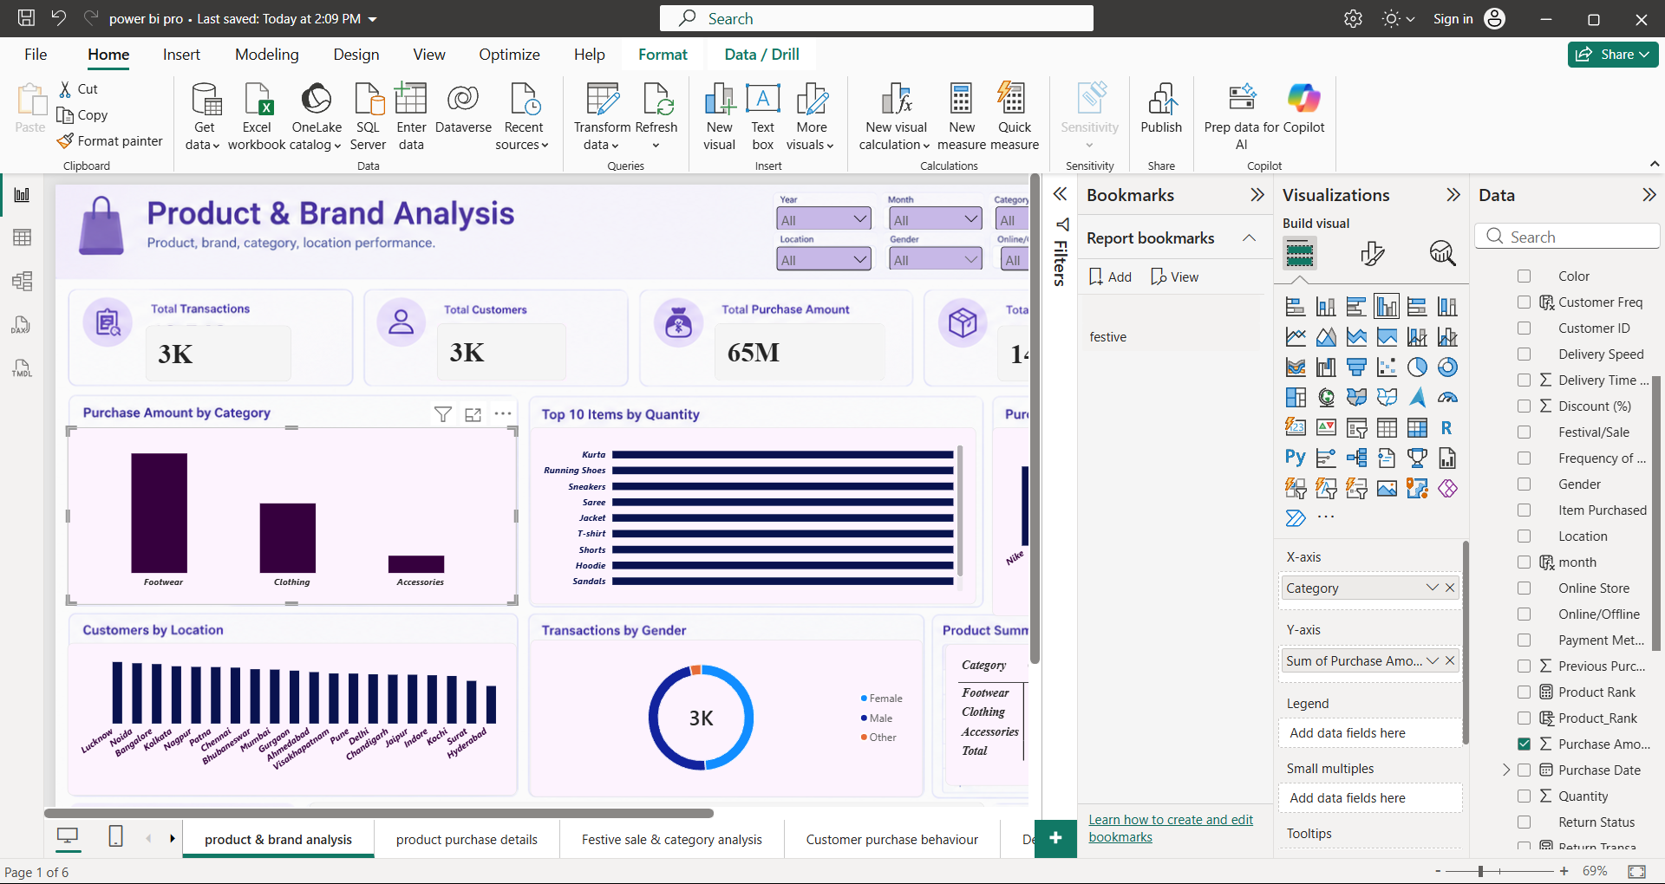
PRODUCT & BRAND ANALYSIS
Insights
Footwear records the highest purchase amount among categories, while Nike leads among the brands shown.
Kurtas, Running Shoes, and Sneakers are among the products highlighted in the quantity analysis.
Drivers
Differences in customer purchasing preferences across product categories and brands.
Variation in product demand and purchasing quantities.
Actions
Prioritize high-performing categories and brands when planning inventory.
Monitor product-level demand to improve stock allocation.

Slide 8
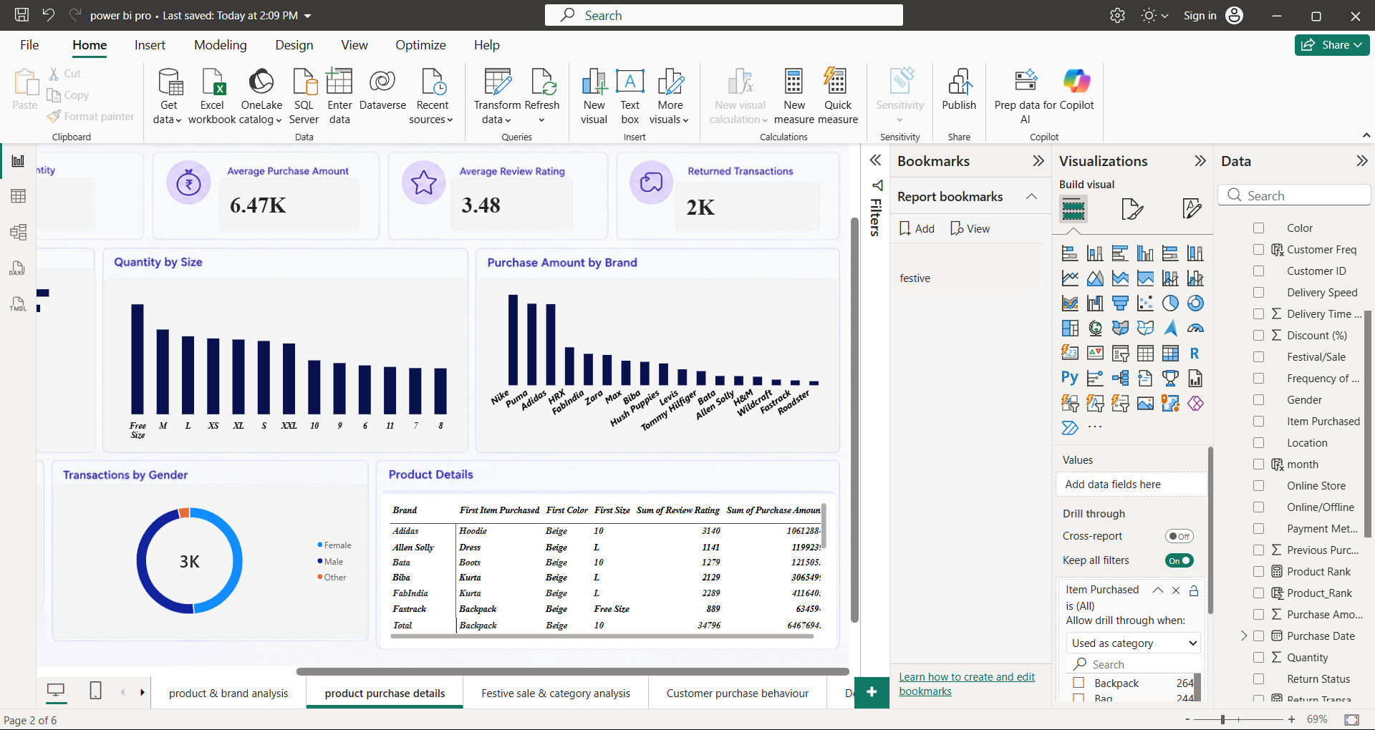
PRODUCT PURCHASE DETAILS
Insights
Free Size records the highest purchase quantity among the sizes shown.
Standard Day records the highest purchase amount among the promotional occasions shown.
Drivers
Differences in customer preferences for product sizes.
Purchasing activity varies across promotional occasions.
Actions
Use size-level purchasing patterns to guide product assortment and stock allocation.
Compare promotional performance when planning future campaigns.

Slide 9
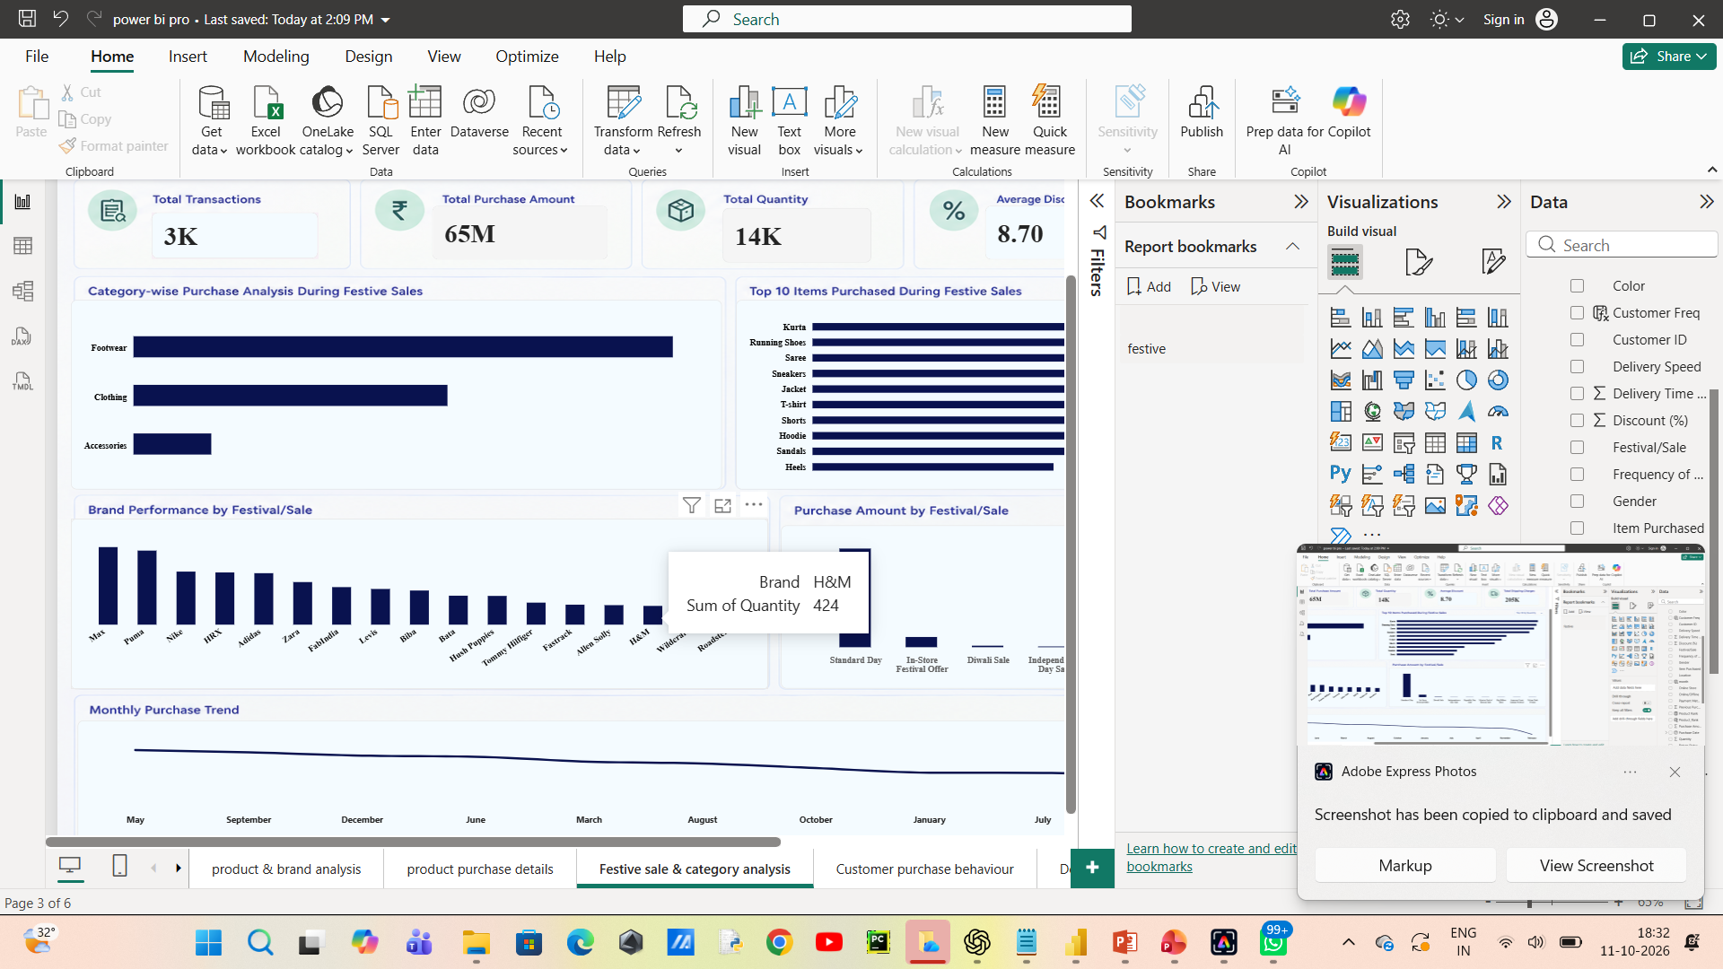
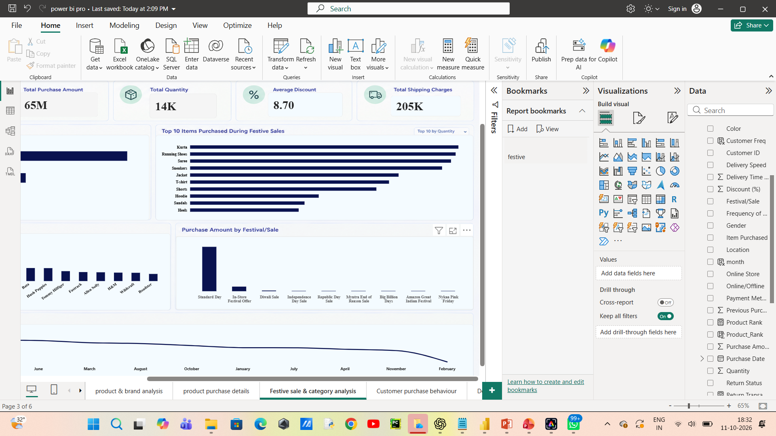
FESTIVE SALES & CATEGORY ANALYSIS
Insights
Compare purchase amounts across promotional occasions to identify the strongest-performing occasions.
Use category-level purchasing patterns and review ratings to evaluate product performance.
Drivers
Differences in purchasing activity across promotional occasions and product categories.
Variation in customer feedback across products or categories.
Actions
Evaluate promotional occasions using purchase amount and quantity.
Investigate products or categories with lower review ratings.

Slide 10
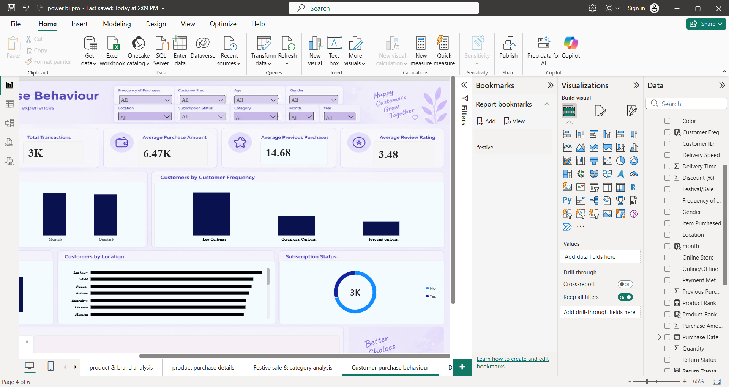
CUSTOMER PURCHASE BEHAVIOUR
Insights
Approximately 971 out of 3,000 customers are subscribed, representing about 32.4%.
Low-frequency customers form the largest purchasing-frequency group in the dashboard.
Drivers
Subscription participation differs between customers.
Purchasing frequency varies across customer groups.
Actions
Explore targeted campaigns to encourage subscriptions and repeat purchases.
Develop customer engagement strategies for low-frequency customers.

Slide 11
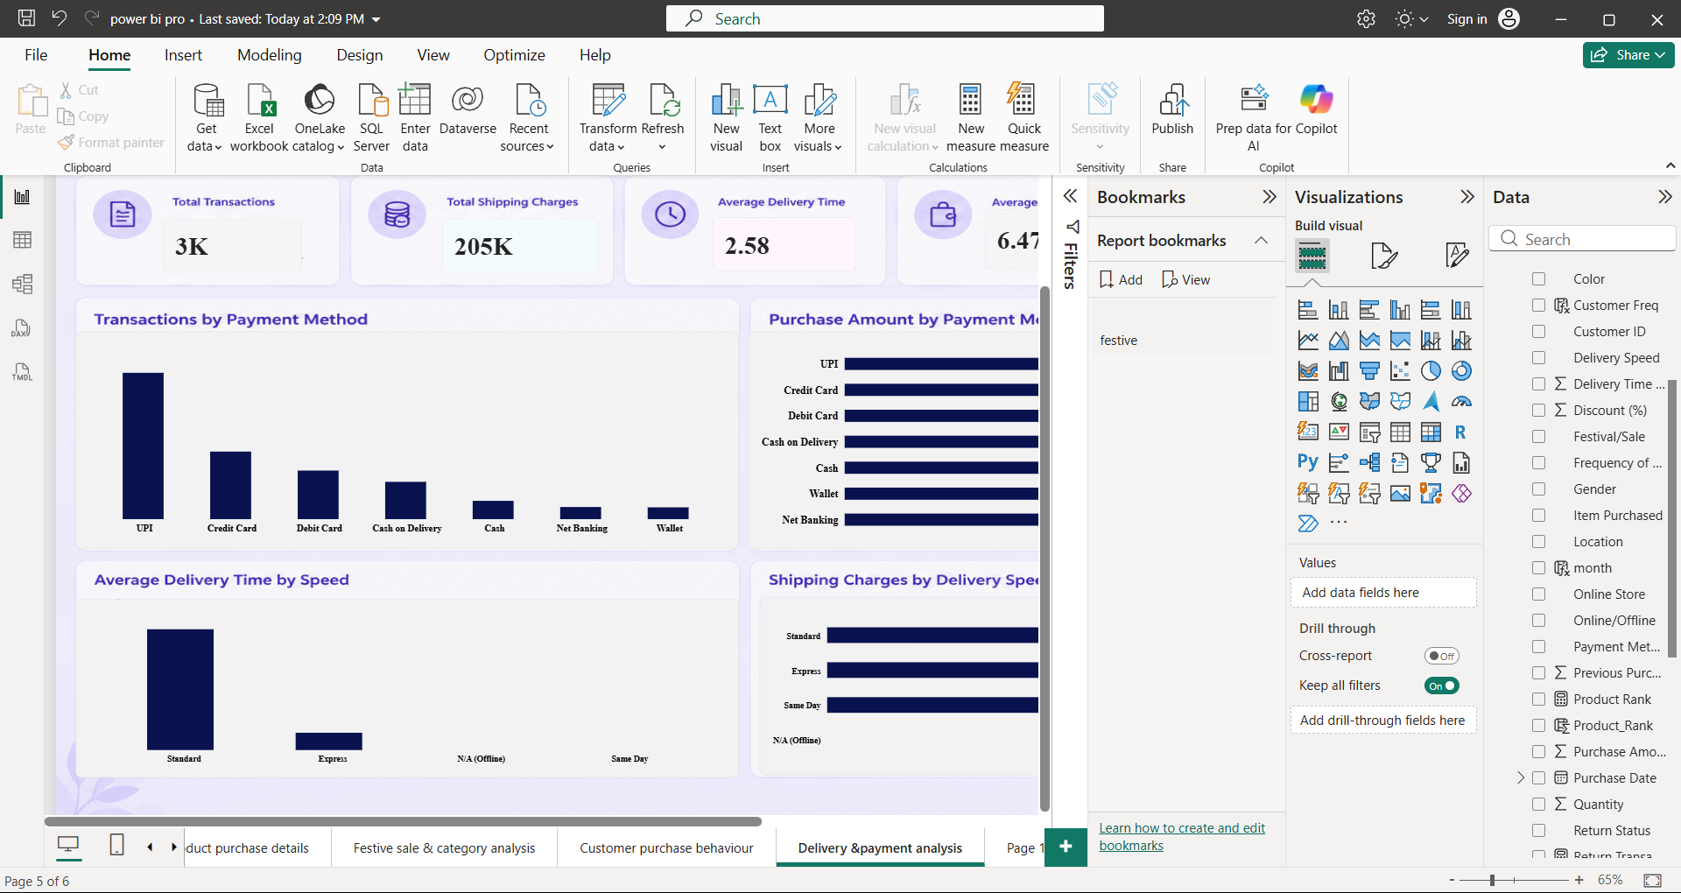
DELIVERY & PAYMENT ANALYSIS
Insights
UPI is the most commonly used payment method in the dashboard.
Standard delivery has a longer average delivery time than Express delivery; the dashboard also shows approximately 2,000 returned transactions.
Drivers
Customers differ in their payment method preferences.
Average delivery time varies by delivery speed, while returned transactions require further investigation.
Actions
Prioritize a smooth checkout experience for commonly used payment methods.
Investigate longer Standard delivery times and examine return patterns to identify potential improvements.

Slide 12
RECOMMENDATIONS
Prioritize high-performing products and brands.
Optimize inventory using customer product preferences.
Strengthen customer retention through targeted marketing.
Improve delivery efficiency and payment convenience.
Investigate product returns and customer feedback.

Slide 13
LIMITATIONS & NEXT STEPS
Analysis depends on the available dataset.
Profitability cannot be fully assessed without cost data.
Time-based trends may be unavailable.
Return reasons may not be recorded.
Observed patterns do not establish causation
Incorporate time-based sales data.
Add product cost and profit information.
Develop advanced customer segmentation.
Investigate product returns and delivery delays.
Explore predictive analytics for demand forecasting

Slide 14
THANK YOU

